Slide 1
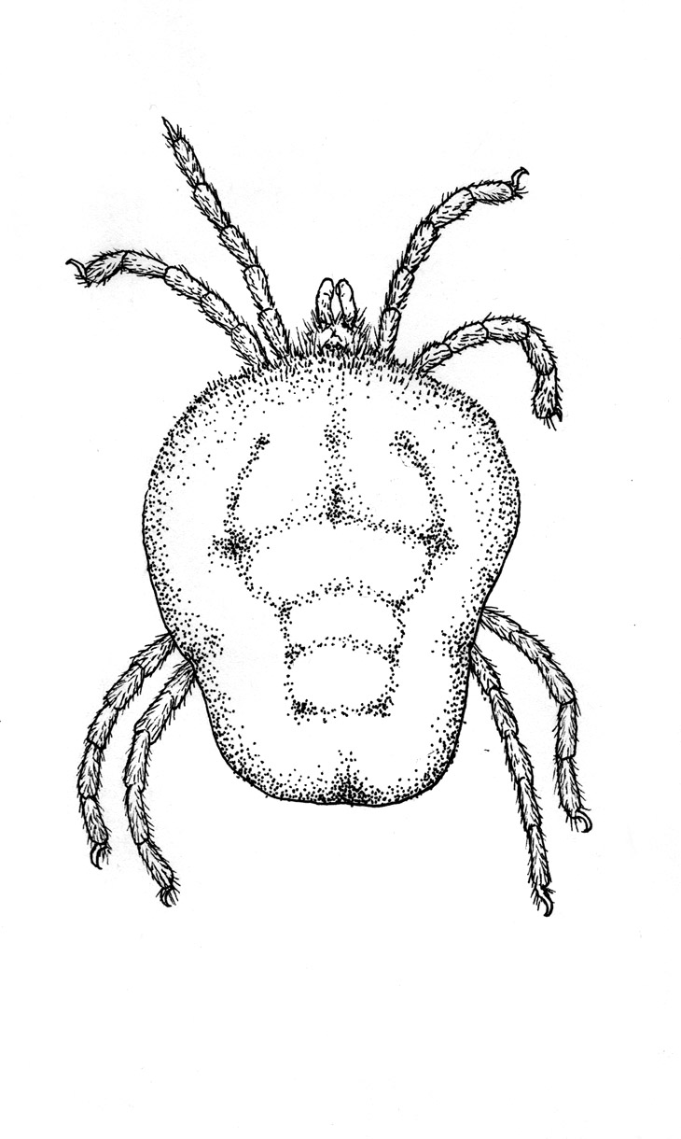

Vegan ordination seminar
Jon Bray & Olivia Burge
University of Canterbury

Slide 2
Vegan ordination seminar
Vegan is an R package for community ecologists. It contains most multivariate analysis needed in analysing ecological communities, and tools for diversity analysis, and other potentially useful functions. Vegan is not self-contained and requires R and other R packages.

Slide 3
Multivariate data
Multivariate: “involving two or more variable quantities”
For example:
Measuring the canopy cover of tree species in the forest
Recording the presence or absence of coral species
Counting the numbers of birds of all species along transect

Slide 4
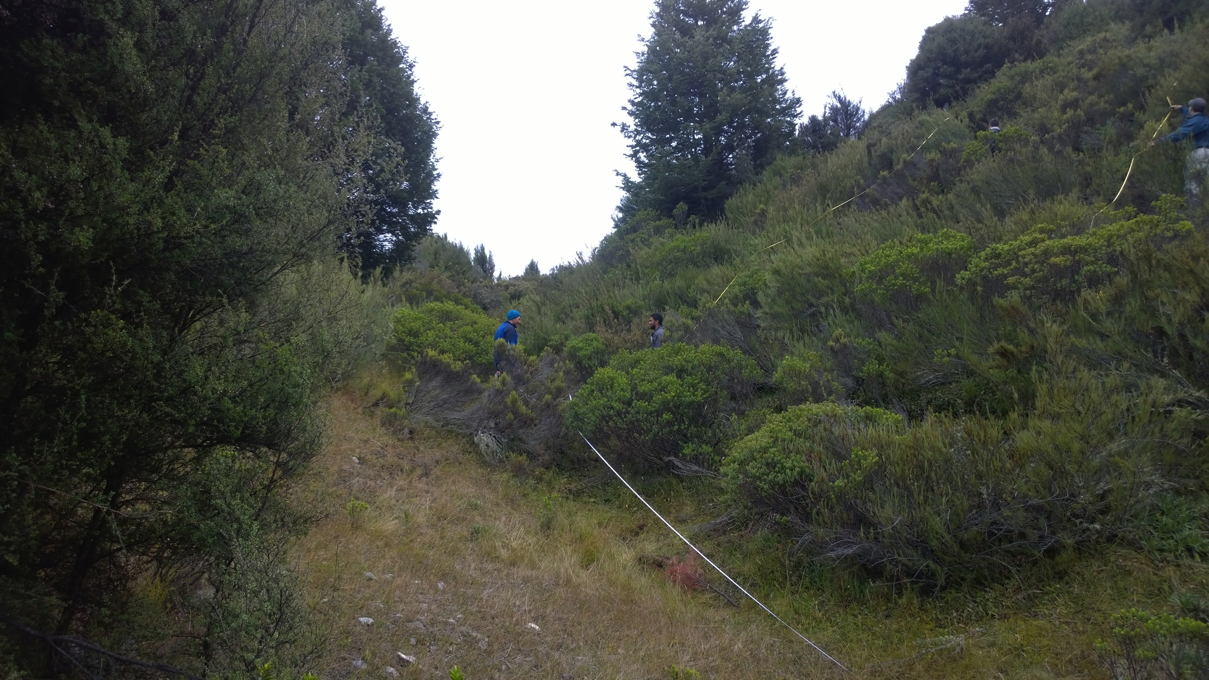
Why ordinations?
Notes:
Ordinations are not so mysterious as they appear. Uses include:
Undergraduate biology class fieldtrip: does the vegetation community differ between northerly (beech and manuka dominated) and southern (ozothamnus and dracophyllum dominated) aspects?

Slide 5
Why ordinations?
Notes:
Short answer – yes

Slide 6

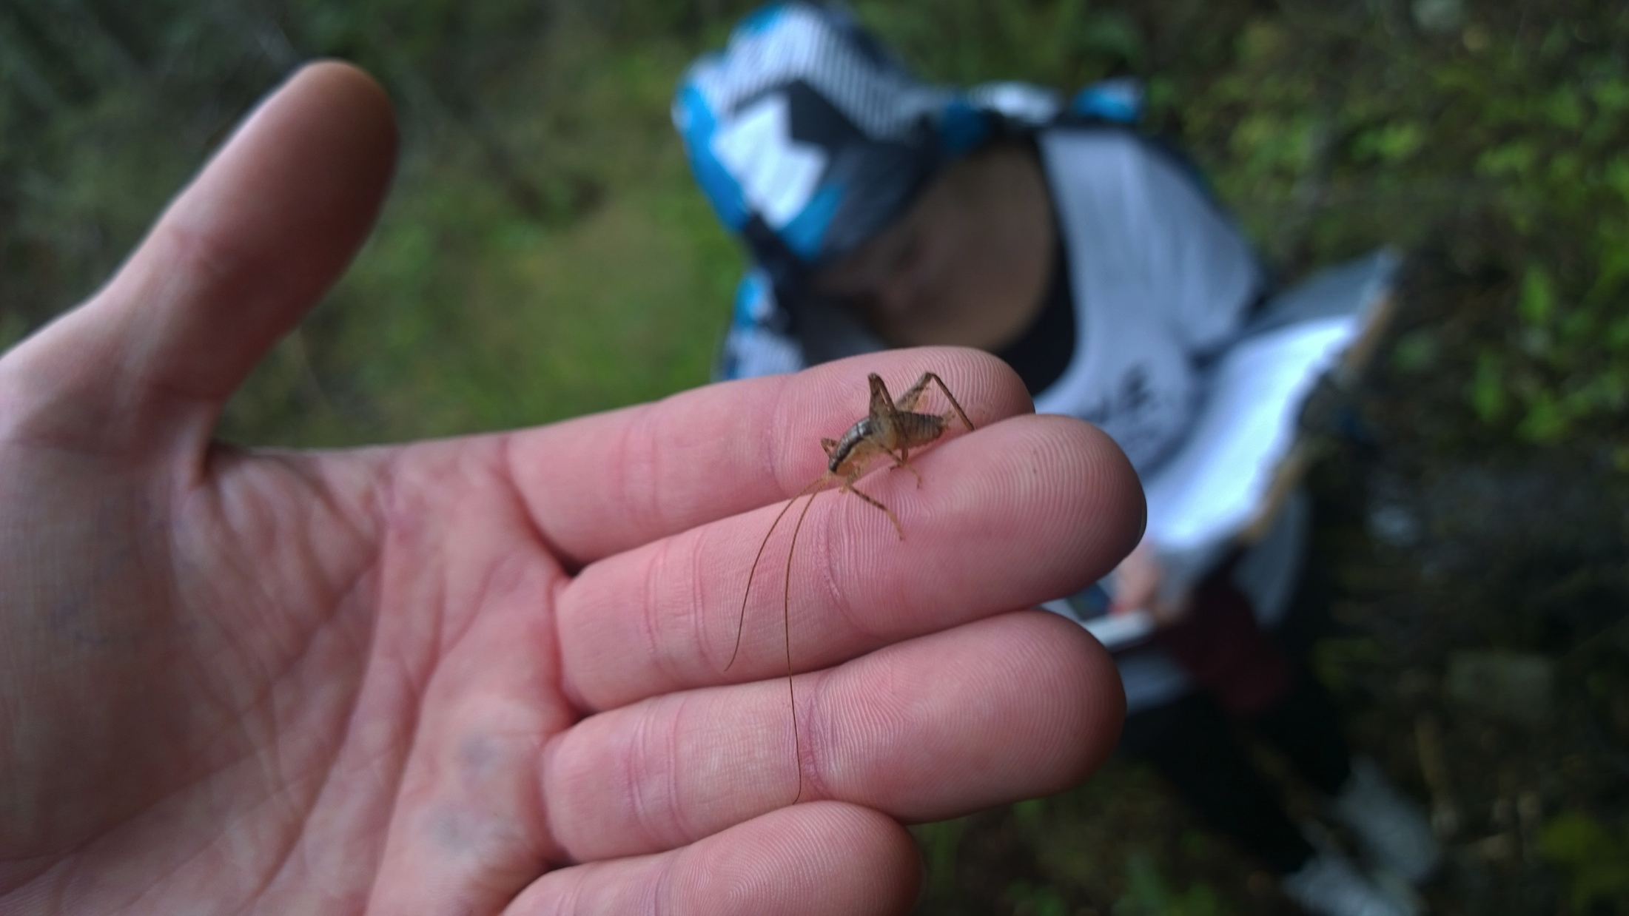
Why ordinations?
Notes:
Which species inhabit weta motels? How does the composition change as distance to edge increases?

Slide 7
Why ordinations?
Notes:
Communities in which tree weta live differ, but strong effect of distance seen

Slide 8
I want to: test details/options
Reduce my variables into composites
PCA
PCA
Get the best fit for community composition based on the environmental predictors
Constrained ordination
RDA (+/- transformation; Euclidean)
dbRDA (non-Euclidean constrained)
CCA (Canonical correspondence analysis)
PCNM (Principle coordinates of neighbourhood matrices)
Special type of constrained
Get the best fit for community
Unconstrained ordination
NMDS
Post-hoc tests
Anosim (difference between means of groups - rank)
Adonis (difference between means of groups – non-parametric)
Betadisper (difference in dispersion between groups)
Notes:
Structure for today’s seminar.

Slide 9
Why ordinations?
Because the data is complex!
Examining community patterns, and drivers of those patterns
Variable decomposition or data reduction (PCA). We may need a latent variable for path analysis or regression.
Data and pattern simplification
Outlier detection
Variable selection – experimental studies.
Interpretation and understanding
Testable hypotheses

Slide 10
Community data is complex:
Species by site matrix
P/A, relative abundance, densities or abundance (see Anderson et al. 2011).
Euclidean, Manhattan, Bray-Curtis, Jaccard, Gower (and modified), Kulczynski etc. (Legendre and Legendre 2012)
Environmental data associated with sites (Niche – sensu Hutchinson 1957).
Spatial gradients to data (Neutral – sensu Hubbel 2001).
Spatial collinearity of environmental predictors.
Deleting rare species (common practice – may yield little valuable information and negatively influence patterns and relationships – >2% of maximum abundance? Division ‘Folk lore’ Jari Oksanen.
Standardisation (Wisconsin, Hellinger, center and standardise (env))
Anderson et al. (2011) Navigating the multiple meanings of β diversity: a roadmap for the practicing ecologist. Ecology Letters, 14: 19-28.
Notes:
Euclidean can pose problems where two sites with no shared species may be considered more closely related than sites that have some of the same species.

Slide 11
Unconstrained
Unconstrained ordinations. These are numerous, some of the common ones are listed here. However collectively they use different algorithms and measures of dissimilarity to maximise explained variation in community data.
Notes:
PCA Conceptually the goal of PCA is to reduce the number of variables of interest into a smaller set of components
• PCA analyzes the all the variance in the in the variables and reorganizes it into a new set of components equal to the number of original variables
• Regarding the new components:
▫ They are independent
▫ They decrease in the amount of variance in the originals they account for
x First component captures most of the variance, 2nd second most and so on until all the variance is accounted for
▫ Only some will be retained for further study (dimension reduction)
x Since the first few capture most of the variance they are typically of focus

Slide 12
Unconstrained - PCA
Principle component analysis (PCA; call:rda) – Analyses variance and reduces these variables into a smaller set of components. Most often used with environmental data for variable reduction. PCA analyzes the all the variance in the in the variables and reorganizes it into a new set of components equal to the number of original variables.
Regarding the components:
They are independent
They decrease in the amount of variance from the originals
First component captures most of the variance, 2nd second most and so on until all the variance is accounted for
These components are orthogonal (i.e. are unrelated to one another).
We generally only retained some for further study (dimension reduction)
Suited to environmental data not community data
Notes:
Conceptually the goal of PCA is to reduce the number of variables of interest into a smaller set of components
• PCA analyzes the all the variance in the in the variables and reorganizes it into a new set of components equal to the number of original variables
• Regarding the new components:
▫ They are independent
▫ They decrease in the amount of variance in the originals they account for
x First component captures most of the variance, 2nd second most and so on until all the variance is accounted for
▫ Only some will be retained for further study (dimension reduction)
x Since the first few capture most of the variance they are typically of focus

Slide 13
Unconstrained - NMDS
Non-metric multidimensional scaling (NMDS; function) A common and accepted method that uses a numerical algorithm that best protrays the rank of inter-sample distances.
Regarded as the most robust unconstrained ordination method for ecological species data (Minchin 1987).
Like other analyses attempts to best represent the position of communities in multidimensional space.
metaMDS (does everything for us)
Iterative, will attempt to find a stable solution with multiple random starts
Automatically standardises (double wisconsin and sqrts if data values are above a threshold)
Notes:
PCA Conceptually the goal of PCA is to reduce the number of variables of interest into a smaller set of components
• PCA analyzes the all the variance in the in the variables and reorganizes it into a new set of components equal to the number of original variables
• Regarding the new components:
▫ They are independent
▫ They decrease in the amount of variance in the originals they account for
x First component captures most of the variance, 2nd second most and so on until all the variance is accounted for
▫ Only some will be retained for further study (dimension reduction)
x Since the first few capture most of the variance they are typically of focus

Slide 14
Unconstrained - DCA
Detrended correspondence analysis (DCA). Hill and Gauch 1980.
Starts by running CA (correspondence analysis)
It then divides the first axis into segments
Rescales each segment to have mean value of zero on the 2nd axis - this effectively squashes the curve flat.
This cures ‘arch effect’ problems where sites that are completely dissimilar than sites that have some common species.
Hill, M.O. and Gauch, H.G. (1980) Detrended Correspondence Analysis: An Improved Ordination Technique. Vegetatio 42, 47–58.
Notes:
It is conceptually similar to principal component analysis, but applies to categorical rather than continuous data.

Slide 15
Post-hoc tests on dissimilarity matrices
Anosim (function:anosim). Analysis of similarities. The method is “philosophically aligned” with NMDS where ranks are used.
The anosim statistic is based on the difference of mean ranks between groups and within groups.
Tests between multiple groups using any type of dissimilarity.
Anosim likely significant

Slide 16
Post-hoc tests on dissimilarity matrices
Adonis (function:adonis). Permutational multivariate analysis of variance using distance matrices. A permutational manova conducted on dissimilarity objects. Considered the best test to date examining group means and variance (Community turn-over ß diversity).
Adonis likely NS
Adonis likely significant

Slide 17
Post-hoc tests on dissimilarity matrices
Betadisper (function:betadisper). Multivariate homogeniety of group dispersions. Examines whether groups differ in their variance only. TukeysHSD tests show differences.
Developed to assist in determining patterns of betadiversity – Community homogenisation
Betadisper significant
Betadisper likely not significant

Slide 18
Run unconstrained analyses and group tests
[see R script from beginning until line 309.
Some introductory material precedes the unconstrained]

Slide 19
Constrained
Constrained ordinations. These are also numerous, some of the common ones are listed here. These analyses attempt to maximise explained variation according to constraints. In this way axes may be considered synthetic combinations of predictors.
Canonical correspondence analysis (CCA; call:cca) – Chi square transformation, subjected to weighted linear regression with constraining variables. CA performed by SVD.
Redundancy analysis (RDA; call:rda), non-metric multidimensional scaling. A common and accepted choice
Distance based redundancy analysis (dbRDA; call:capscale), a newer method that allows the use of varying measures of dissimilarity.
Principal coordinates of neighbour hood matrices (PCNM; call:pcnm). Ordination carried out on coordinates. Then constrained, and uses truncated distances. Allows broad to fine scale spatial characterisation.
Notes:
Chi-square transformed data matrix is subjected to weighted linear regression on constraining variables, and the fitted values are submitted to correspondence analysis performed via singular value decomposition. With weighted linear regression of constraining variables more weight is given to data points that are assumed to have less error associated with them.
Function rda is similar, but uses ordinary, unweighted linear regression and unweighted SVD.
SVD or singular value decomposition involves.
Each of these methods have numerous papers about them. The above is only the briefest of synopses for the practicing ecologist.

Slide 20
Partial constrained
With partial constrained ordinations we first account for the variability in one or more predictors (or co-variables) and then perform a constrained ordination on the others.
Variance partitioning: This is a relatively new technique but allows for partialling of multiple predictor matrices (or single variables). For instance we have our species matrix, but also have a physical environmental matrix, and a matrix of anthropogenic impact, and a spatial matrix (PCNM). We can examine these individually, and could stepwise partial, but variance partitioning handles much of this for us.

Slide 21
Principle coordinates of neighbour hood matrix – Spatial decomposition
PCNM (Borcard & Legendre 2002) – This is an analysis specifically designed to decompose coordinate data to best elucidate spatial patterns and make them useable to ordinations.
Allows examination of fine to broad scale spatial structuring within communities, but also environmental drivers (spatial autocorrelation).
Truncates data thus expanding the number of synthetic gradients.
Early vectors represent broad scale variation, later vectors finer scales.
Borcard and Legendre (2002) All-scale spatial analysis of ecological data by means of principal coordinates of neighbour matrices. Ecological Modelling 153 (2002) 51–68.

Slide 22
Unconstrained and constrained are complementary!
So use both, they examine the problem from different angles.
Partial constrained ordinations are also common and are great for examining specific drivers. But be careful with their interpretation.
Variance partitioning is a fantastic tool for understanding the bigger picture. Which suites of variables are most influential, and is there overlap?

Slide 23
Notes:
Jon discusses his use of variance partitioning in his thesis here (example of RDA).

Slide 24
Very, very, brief synopsis
Examine carefully the analyses you are using and look at the literature for examples and best practice.
Unconstrained maximise variation in the community data.
Constrained maximise explained variation according to constraining variable. Linear combinations.
Be critical and have a goal in mind. Sometimes having effective means of analysing very large data sets might lead to:
improper study design,
data mining without examining sensible hypotheses, and then
inflation of type 1 or false positives.
Relationships are correlative

Slide 25
Reading.
Vegan FAQ (FAQ-vegan.pdf).
Short introduction to basic ordination methods in vegan (intro-vegan.pdf).
Introduction to diversity methods in vegan (diversity-vegan.pdf).
Discussion on design decisions in vegan (decision-vegan.pdf).
Description of variance partition procedures in function varpart (partitioning.pdf).

Slide 26
More reading.
Web documents outside the package include:
http://cc.oulu.fi/~jarioksa/softhelp/vegan.html: vegan homepage.
http://cc.oulu.fi/~jarioksa/opetus/metodi/vegantutor.pdf: vegan tutorial.
http://wiki.r-project.org/: entry in R-Wiki.
Anderson et al. (2011) Navigating the multiple meanings of β diversity: a roadmap for the practicing ecologist. Ecology Letters, 14: 19-28.
Borcard and Legendre (2002) All-scale spatial analysis of ecological data by means of principal coordinates of neighbour matrices. Ecological Modelling 153 (2002) 51–68.

